Slide 1
PHP Programming with MySQL
Day 5

Slide 2
Understanding File Types and Permissions
File types affect how information is stored in files and retrieved from them
File permissions determine the actions that a specific user can and cannot perform on a file
A binary file is a series of characters or bytes for which PHP attaches no special meaning
Structure is determined by the application that reads or writes to the file
A text file has only printable characters and a small set of control or formatting characters
Text files translate the end-of-line character sequences such as \n or \r\n to carriage returns

Slide 3
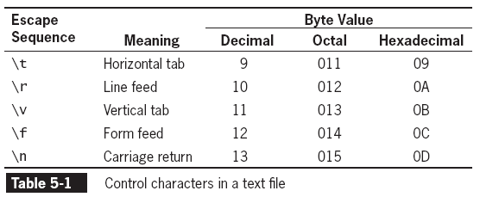
Understanding File Types

Slide 4
Understanding File Types
Different operating systems use different escape sequences to identify the end of a line:
Use the \n sequence to end a line on a UNIX/Linux operating system
Use the \n\r sequence to end a line on a Windows operating system
Use the \r sequence to end a line on a Macintosh operating system.

Slide 5
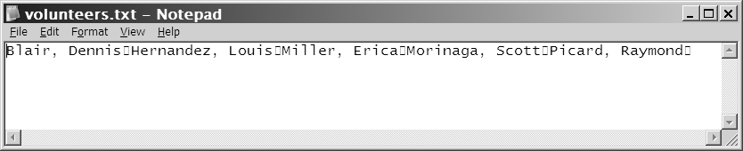
Understanding File Types
Scripts written in a UNIX/Linux text editor display differently when opened in a Windows-based text editor
Figure 5-1 Volunteer registration form

Slide 6
Working with File Permissions
Files and directories have three levels of access:
User
Group
Other
The three typical permissions for files and directories are:
Read (r)
Write (w)
Execute (x)

Slide 7
Working with File Permissions
File permissions are calculated using a four-digit octal (base 8) value
Octal values encode three bits per digit, which matches the three permission bits per level of access
The first digit is always 0
To assign more than one value to an access level, add the values of the permissions together

Slide 8
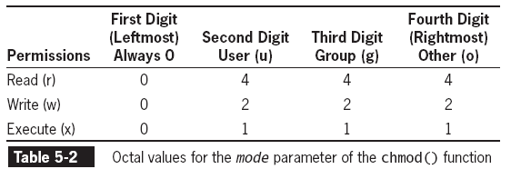
Working with File Permissions
What does 0755 permission mean?

Slide 9
Working with File Permissions
The chmod() function is used to change the permissions or modes of a file or directory
The syntax for the chmod() function is
chmod($filename, $mode)
Where $filename is the name of the file to change and $mode is an integer specifying the permissions for the file

Slide 10
Checking Permissions
The fileperms() function is used to read permissions associated with a file
The fileperms() function takes one argument and returns an integer bitmap of the permissions associated with the file
Permissions can be extracted using the arithmetic modulus operator with an octal value of 01000
The dococt() function converts a decimal value to an octal value

Slide 11
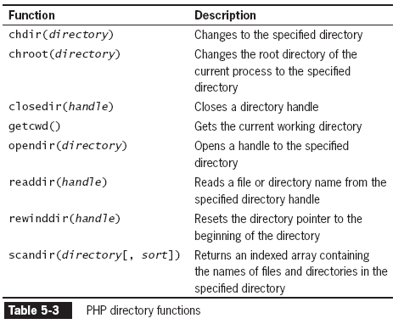
Reading Directories
The following table lists the PHP functions that read the names of files and directories

Slide 12
Reading Directories
The opendir() function is used to iterate through entries in a directory
A handle is a special type of variable that PHP used to represent a resource such as a file or a directory
The readdir() function returns the file and directory names of an open directory
The directory pointer is a special type of variable that refers to the currently selected record in a directory listing

Slide 13
Reading Directories
The closedir() function is used to close the directory handle
The following code lists the files in the open directory and closes the directory.
$Dir = "/var/html/uploads";
$DirOpen = opendir($Dir);
while ($CurFile = readdir($DirOpen)) {
echo $CurFile . "<br />\n";
}
closedir($DirOpen);

Slide 14
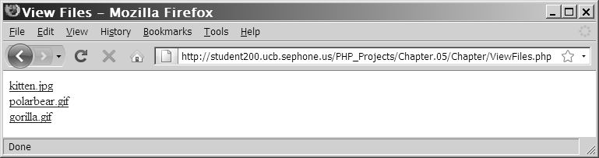
Reading Directories
The following Figure shows the directory listing for three files: kitten.jpg, polarbear.jpg, and gorilla.gif
Figure 5-2 Listing of the “files” subdirectory using the opendir(), readdir(), and closedir() functions

Slide 15
Reading Directories
The PHP scripting engine returns the navigation shortcuts (“.” and “..”) when it reads a directory
The strcmp() function can be used to exclude those entries
…
while ($CurFile = readdir($DirOpen))
if ((strcmp($CurFile, '.') != 0) &&
(strcmp($CurFile, '..') != 0))
echo "<a href=\"files/" . $CurFile . "\">" . $CurFile . "</a><br />";
}
…

Slide 16
Reading Directories
The scandir() function returns the names of the entries in a directory to an array sorted in ascending alphabetical order
$Dir = "/var/html/uploads";
$DirEntries = scandir($Dir);
foreach ($DirEntries as $Entry) {
echo $Entry . "<br />\n";
}

Slide 17
Creating Directories
The mkdir() function creates a new directory
To create a new directory within the current directory:
Pass just the name of the directory you want to create to the mkdir() function
mkdir("volunteers");

Slide 18
Creating Directories
To create a new directory in a location other than the current directory:
Use a relative or an absolute path
mkdir("../event");
mkdir("/bin/PHP/utilities");

Slide 19
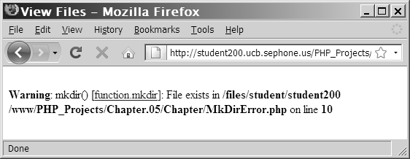
Creating Directories
Figure 5-4 Warning that appears if a directory already exists

Slide 20
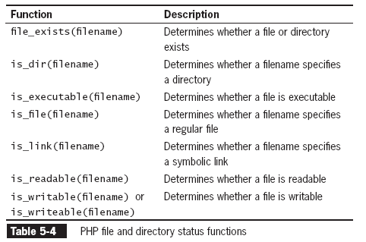
Obtaining File and Directory Information

Slide 21
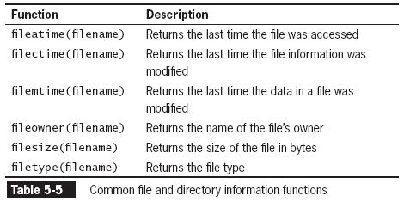
Obtaining File and Directory Information

Slide 22
Obtaining File and Directory Information
$Dir = "/var/html/uploads";
if (is_dir($Dir)) {
echo "<table border='1' width='100%'>\n";
echo "<tr><th>Filename</th><th>File Size</th>
<th>File Type</th></tr>\n";
$DirEntries = scandir($Dir);
foreach ($DirEntries as $Entry) {
$EntryFullName = $Dir . "/" . $Entry;
echo "<tr><td>" . htmlentities($Entry) . "</td><td>" .
filesize($EntryFullName) . "</td><td>" .
filetype($EntryFullName) . "</td></tr>\n";
}
echo "</table>\n";
} else {
echo "<p>The directory " . htmlentities($Dir) . " does not exist.</p>";
}

Slide 23
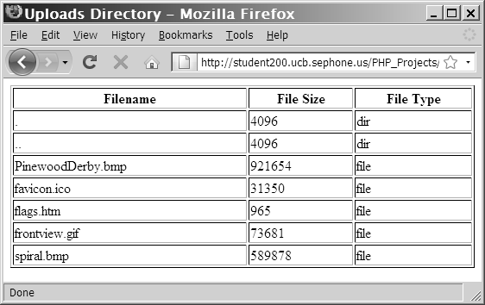
Obtaining File and Directory Information
Figure 5-5 Output of script with file and directory
information functions

Slide 24
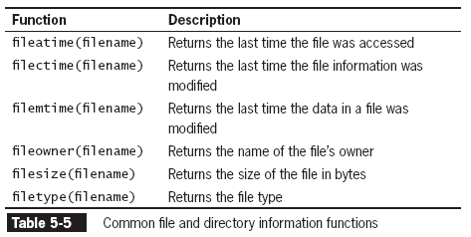
Obtaining File and Directory Information
The following table returns additional information about files and directories:

Slide 25
Uploading and Downloading Files
Web applications allow visitors to upload files to and from from their local computer (often referred to as the client)
The files that are uploaded and downloaded may be simple text files or more complex file types, such as images, documents, or spreadsheets

Slide 26
Selecting the File
Files are uploaded through an HTML form using the “post” method
An enctype attribute in the opening form tag must have a value of “multipart/form-data,” which instructs the browser to post multiple sections – one for regular form data and one for the file contents
The file input field creates a Browse button for the user to navigate to the appropriate file to upload
<input type="file" name="picture_file" />
The MAX_FILE_SIZE (uppercase) attribute of a hidden form field specifies the maximum number of bytes allowed in the uploaded file
The MAX_FILE_SIZE hidden field must appear before the file input field

Slide 27
Retrieving the File Information
When the form is posted, information for the uploaded file is stored in the $_FILES autoglobal array
The $_FILES[] array contains five elements:
$_FILES['picture_file']['error'] // Contains the error code associated with the file
$_FILES['picture_file']['tmp_name'] // Contains the temporary location of the file contents
$_FILES['picture_file']['name'] // Contains the name of the original file
$_FILES['picture_file']['size'] // Contains the size of the uploaded file in bytes
$_FILES['picture_file']['type'] // Contains the type of the file

Slide 28
Storing the Uploaded File
Uploaded files are either public or private depending on whether they should be immediately available or verified first
Public files are freely available to anyone visiting the Web site
Private files are only available to authorized visitors

Slide 29
Storing the Uploaded File
The move_uploaded_file() function moves the uploaded file from its temporary location to a permanent destination with the following syntax:
bool move_uploaded_file(string $filename, string $destination)
$filename is the contents of $_FILES['filefield']['tmp_name'] and $destination is the path and filename of the location where the file will be stored.

Slide 30
Storing the Uploaded File
The function returns TRUE if the move succeeds, and FALSE if the move fails
if (move_uploaded_file($_FILES['picture_file']['tmp_name'], "uploads/" . $_FILES['picture_file']['name']) === FALSE) {
echo "Could not move uploaded file to \"uploads/" . htmlentities($_FILES['picture_file']['name']) . "\"<br />\n";
} else {
echo "Successfully uploaded \"uploads/" . htmlentities($_FILES['picture_file']['name']) . "\"<br />\n";
}

Slide 31
Downloading Files
Files in the public XHTML directory structure can be downloaded with an XHTML hyperlink
Files outside the public XHTML directory require a three-step process:
Tell the script which file to download
Provide the appropriate headers
Send the file
The header() function is used to return header information to the Web browser

Slide 32
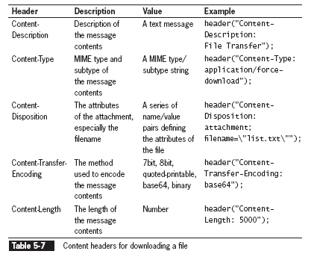
Downloading Files

Slide 33
Exercise
Create a web form for uploading pictures for a high school reunion. The form should have text input fields for the person’s name and a file input field for the image.
Create a separate web page that displays the pictures with a caption showing the person’s name.

Slide 34
Writing an Entire File
PHP supports two basic functions for writing data to text files:
file_put_contents() function writes or appends a text string to a file and returns the number of bytes written to the file
fwrite() function incrementally writes data to a text file
The file_put_contents() function writes or appends a text string to a file
The syntax for the file_put_contents() function is:
file_put_contents (filename, string[, options])

Slide 35
Writing an Entire File Example
$EventVolunteers = " Blair, Dennis\n ";
$EventVolunteers .= " Hernandez, Louis\n ";
$EventVolunteers .= " Miller, Erica\n ";
$EventVolunteers .= " Morinaga, Scott\n ";
$EventVolunteers .= " Picard, Raymond\n ";
$VolunteersFile = " volunteers.txt ";
file_put_contents($VolunteersFile, $EventVolunteers);

Slide 36
Writing an Entire File
If no data was written to the file, the function returns a value of 0
Use the return value to determine whether data was successfully written to the file
if (file_put_contents($VolunteersFile, $EventVolunteers) > 0)
echo "<p>Data was successfully written to the
$VolunteersFile file.</p>";
else
echo "<p>No data was written to the $VolunteersFile file.</p>";

Slide 37
Writing an Entire File
The FILE_USE_INCLUDE_PATH constant searches for the specified filename in the path that is assigned to the include_path directive in your php.ini configuration file
The FILE_APPEND constant appends data to any existing contents in the specified filename instead of overwriting it

Slide 38
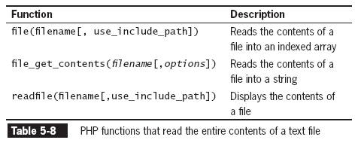
Reading an Entire File

Slide 39
Reading an Entire File
The file_get_contents() function reads the entire contents of a file into a string
$DailyForecast = "<p><strong>San Francisco daily weather
forecast</strong>: Today: Partly cloudy. Highs from the 60s to
mid 70s. West winds 5 to 15 mph. Tonight: Increasing clouds. Lows
in the mid 40s to lower 50s. West winds 5 to 10 mph.</p>";
file_put_contents("sfweather.txt", $DailyForecast);
$SFWeather = file_get_contents("sfweather.txt");
echo $SFWeather;

Slide 40
Reading an Entire File
The readfile() function displays the contents of a text file along with the file size to a Web browser
readfile("sfweather.txt");

Slide 41
Reading an Entire File
The file() function reads the entire contents of a file into an indexed array
Automatically recognizes whether the lines in a text file end in \n, \r, or \r\n
$January = " 61, 42, 48\n ";
$January .= "62, 41, 49\n ";
$January .= " 62, 41, 49\n ";
$January .= " 64, 40, 51\n ";
$January .= " 69, 44, 55\n ";
$January .= " 69, 45, 52\n ";
$January .= " 67, 46, 54\n ";
file_put_contents("sfjanaverages.txt", $January);

Slide 42
Reading an Entire File
$JanuaryTemps = file("sfjanaverages.txt");
for ($i=0; $i<count($JanuaryTemps); ++$i) {
$CurDay = explode(", ", $JanuaryTemps[$i]);
echo "<p><strong>Day " . ($i + 1) . "</strong><br />";
echo "High: {$CurDay[0]}<br />";
echo "Low: {$CurDay[1]}<br />";
echo "Mean: {$CurDay[2]}</p>";
}

Slide 43
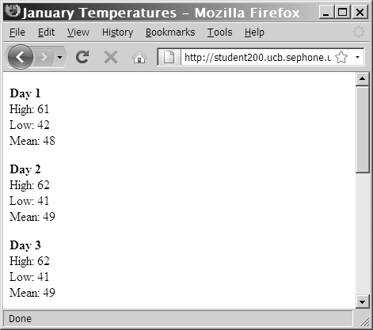
Reading an Entire File
Figure 5-13 Output of individual lines in a text file

Slide 44
Opening and Closing File Streams
A stream is a channel used for accessing a resource that you can read from and write to
The input stream reads data from a resource (such as a file)
The output stream writes data to a resource
1. Open the file stream with the fopen() function
2. Write data to or read data from the file stream
3. Close the file stream with the fclose() function

Slide 45
Opening a File Stream
A handle is a special type of variable that PHP uses to represent a resource such as a file
The fopen() function opens a handle to a file stream
The syntax for the fopen() function is:
open_file = fopen("text file", " mode");
A file pointer is a special type of variable that refers to the currently selected line or character in a file

Slide 46
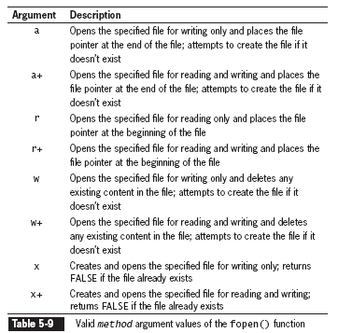
Opening a File Stream

Slide 47
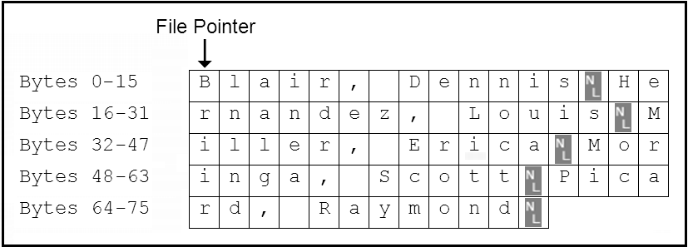
Opening a File Stream
$VolunteersFile = fopen(“volunteers.txt", “r+");
Figure 5-15 Location of the file pointer when the fopen() function uses a mode argument of “r+”

Slide 48
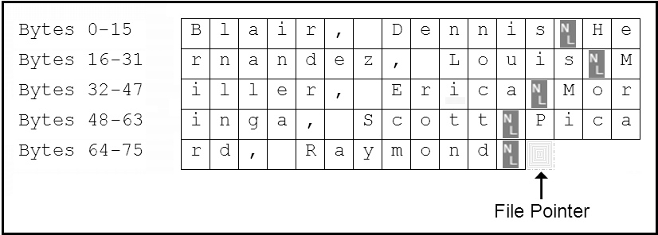
Opening a File Stream (continued)
$VolunteersFile = fopen(“volunteers.txt", “a+");
Figure 5-16 Location of the file pointer when the fopen() function uses a mode argument of “a+”

Slide 49
Closing a File Stream
Use the fclose function when finished working with a file stream to save space in memory
Use the statement fclose($handle); to ensure that the file doesn’t keep taking up space in your computer’s memory and allow other processes to read to and write from the file

Slide 50
Writing Data Incrementally
Use the fwrite() function to incrementally write data to a text file
The syntax for the fwrite() function is: fwrite($handle, data[, length]);
The fwrite() function returns the number of bytes that were written to the file
If no data was written to the file, the function returns a value of 0

Slide 51
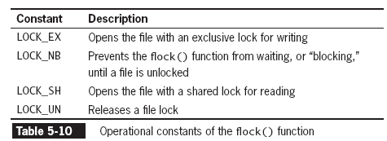
Locking Files
To prevent multiple users from modifying a file simultaneously use the flock() function
The syntax for the flock() function is:
flock($handle, operation)

Slide 52
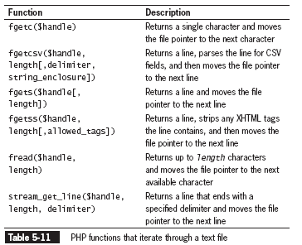
Reading Data Incrementally
The fgets() function uses the file pointer to iterate through a text file

Slide 53
Reading Data Incrementally
You must use fopen() and fclose() with the functions listed in Table 5-10
Each time you call any of the functions in Table 5-10, the file pointer automatically moves to the next line in the text file (except for fgetc())
Each time you call the fgetc() function, the file pointer moves to the next character in the file

Slide 54
Managing Files and Directories
PHP can be used to manage files and the directories that store them
Among the file directory and management tasks for files and directories are
Copying
Moving
Renaming
Deleting

Slide 55
Copying and Moving Files
Use the copy() function to copy a file with PHP
The function returns a value of TRUE if it is successful or FALSE if it is not
The syntax for the copy() function is:
copy(source, destination)
For the source and destination arguments:
Include just the name of a file to make a copy in the current directory, or
Specify the entire path for each argument

Slide 56
Copying and Moving Files (continued)
if (file_exists(" sfweather.txt ")) {
if(is_dir(" history ")) {
if (copy(" sfweather.txt ",
" history\\sfweather01-27-2006.txt "))
echo " <p>File copied successfully.</p> ";
else
echo " <p>Unable to copy the file!</p> ";
} else {
echo (" <p>The directory does not exist!</p> ");
}
} else {
echo (" <p>The file does not exist!</p> ");
}

Slide 57
Renaming Files and Directories
Use the rename() function to rename a file or directory with PHP
The rename() function returns a value of true if it is successful or false if it is not
The syntax for the rename() function is:
rename(old_name, new_name)

Slide 58
Removing Files and Directories
Use the unlink() function to delete files and the rmdir() function to delete directories
Pass the name of a file to the unlink() function and the name of a directory to the rmdir() function
Both functions return a value of true if successful or false if not
Use the file_exists() function to determine whether a file or directory name exists before you attempt to delete it

Slide 59
Summary
In PHP, a file can be one of two types: binary or text
A binary file is a series of characters or bytes for which PHP attaches no special meaning
A text file has only printable characters and a small set of control of formatting characters
A text file translates the end-of-line character sequences in code display
The UNIX/Linux platforms end a line with the \n sequence
The Windows platforms end a line with the \n\r sequence
The Macintosh platforms end a line with the \r sequence
Files and directories have three levels of access: user, group, and other
Typical file and directory permissions include read, write, and execute
PHP provides the chmod() function for changing the permissions of a file within PHP

Slide 60
Summary
The syntax for the chmod()function is chmod($filename, $mode)
The chmod() function uses a four-digit octal value to assign permissions
The fileperms(), which takes filename as the only parameter, returns a bitmap of the permissions associated with a file
The opendir() function iterates through the entries in a directory
A handle is a special type of variable that represents a resource, such as a file or directory
To iterate through the entries in a directory, you open a handle to the directory with the opendir() function
Use the readdir() function to return the file and directory names from the open directory
Use the closedir() function to close a directory handle

Slide 61
Summary
The scandir() function returns an indexed array of the files and directories ( in ascending alphabetical order) in a specified directory
The mkdir(), with a single name argument, creates a new directory
The is_readable(), is_writeable(), and is_executable() functions check the the file or directory to determine if the PHP scripting engine has read, write, or execute permissions, respectively
A symbolic link, which is identified with the is_link() is a reference to a file not on the system
The is_dir() determines if a directory exists
Directory information functions provide file access dates, file owner, and file type
Uploading a file refers to transferring the file to a Web server

Slide 62
Summary
Setting the enctype attribute of the opening from tag to multipart/form-data instructs the browser to post one section for regular form data and one section for file contents
The file input type creates a browse button that allows the user to navigate to a file to upload
To limit the size of the file upload, above the file input field, insert a hidden field with an attribute MAX_FILE_SIZE and a value in bytes
An uploaded file’s information (error code, temporary file name, filename, size, and type) is stored in the $_FILES array
MIME (Multipurpose Internet Mail Extension) generally classifies the file upload as in “image.gif”, “image.jpg”, “text/plain,” or “text/html”
The move_uploaded_file() function moves the uploaded file to its permanent destination

Slide 63
Summary
The file_put_contents() function writes or appends a text string to a file and returns the number of bytes written to the file
The FILE_APPEND constant appends data to any existing contents in the specified filename instead of overwriting it
The file_get_contents() and readfile() functions read the entire contents of a file into a string
A stream is a channel that is used for accessing a resource to which you may read, and write.
The input stream reads data from a resource, such as a file
The output stream writes data to a resource, such as a file
The fopen() opens a handle to a file stream using the syntax $open_file = fopen("text file", "mode");

Slide 64
Summary
A file pointer is a variable that refers to the currently selected line or character in a file
Mode arguments used with the fopen() function specifies if the file is opened for reading, writing, or executing, and the indicates the location of the file pointer
The fclose() function with a syntax of fclose($handle); is used to close a file stream
The fwrite() incrementally writes data to a text file
To prevent multiple users from modifying a file simultaneously use the flock() function
A number of PHP functions are available to iterate through a text file by line or character
Use the copy() function to copy a file with PHP
Use the rename() function to rename a file or directory with PHP

Slide 65
Summary
The unlink() function is used to delete files and the rmdir() function is used to delete directories
In lieu of a move function, the rename() function renames a file and specifies a new directory to store the renamed file

Slide 66
Exercise
Follow the directions in Exercise 5-2, page 289 in the book, to create an online Guest Book.
Add a search function to the online Guest Book that you created.
The function should search (case insensitive) through all fields of the guest book and display only the records that match the search input.

